Slide 1


ISTQB Certified Tester Foundation Level
Module 1 of 6 : Fundamentals of Testing
February, 2017
Notes:
Disclaimer: The following slide pack has been produced from the ISTQB syllabus and various examples from the internet as referenced.
The study material in this form can not be used for commercial purposes without accreditation from the required ISTQB Testing Board.
(See copyright information stated in the ISTQB Syllabus) Also, the ISTQB logo can not be used unless the material is accredited.
NOTE: THIS IS NOT INTENDED TO BE AN ACCREDITED ISTQB COURSE.
The objective of the material is assist study sessions for discussion and learning of the syllabus.
Disclaimer: The following slide pack has been produced from the ISTQB syllabus and various examples from the internet as referenced.
The study material in this form can not be used for commercial purposes without accreditation from the required ISTQB Testing Board.
(See copyright information stated in the ISTQB Syllabus) Also, the ISTQB logo can not be used unless the material is accredited.
NOTE: THIS IS NOT INTENDED TO BE AN ACCREDITED ISTQB COURSE.
The objective of the material is assist study sessions for discussion and learning of the syllabus.

Slide 2
Introduction (1/5) : About the ISTQB
International Software Testing Qualifications Board (ISTQB)
Non-profit organization with voluntary contributions to syllabi and exams from Testing experts across the globe
47 national Testing Boards
Including the <Indian Board>
More than 145,000 certified Testers across the world
Over 9,000 Foundation Level certified in <INDIA>
ZenQ is an affiliate member of Indian Testing Board.
ISTQB Vision:
“Enabling Test Professionals, through Globally accepted Software Testing Certification standards to support their career development, built on solid professional foundations and exemplary organizational culture. ”

Slide 3
Introduction(2/5) : Benefits of ISTQB Certification
Internationally recognized qualification
Becoming the standard for Testing Professionals
Promotes a common language for testers
Promotes consistent and good testing practices
Enables professionally qualified testers to be recognized
Provides a framework for the development of tester’ careers

Slide 4
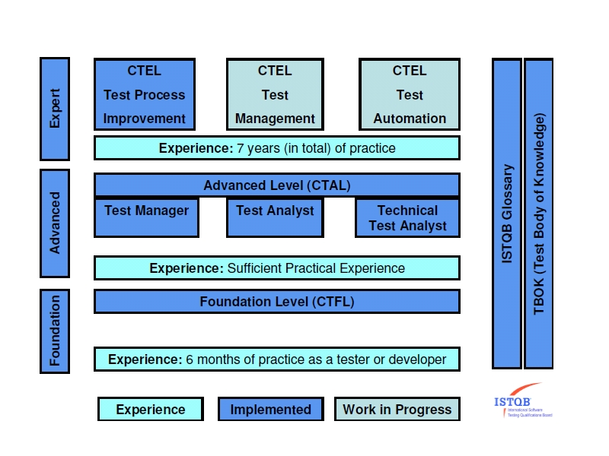
Introduction (3/5) : ISTQB Framework

Slide 5
Introduction(5/5) : Study Sessions
These study packs are intended as sessions directly from the chapters in the syllabus
There are 6 main modules
Fundamentals of Testing
Testing Throughout the Software Life Cycle
Static Techniques
Test Design Techniques
Test Management
Tool Support for Testing

Slide 6
Module 1of 6
FUNDAMENTALS OF TESTING
Notes:
Learning Objectives – from syllabus!
1.1 Why is Testing Necessary? (K2)
LO-1.1.1 Describe, with examples, the way in which a defect in software can cause harm to a
person, to the environment or to a company (K2)
LO-1.1.2 Distinguish between the root cause of a defect and its effects (K2)
LO-1.1.3 Give reasons why testing is necessary by giving examples (K2)
LO-1.1.4 Describe why testing is part of quality assurance and give examples of how testing
contributes to higher quality (K2)
LO-1.1.5 Explain and compare the terms error, defect, fault, failure and the corresponding terms
mistake and bug, using examples (K2)
1.2 What is Testing? (K2)
LO-1.2.1 Recall the common objectives of testing (K1)
LO-1.2.2 Provide examples for the objectives of testing in different phases of the software life
cycle (K2)
LO-1.2.3 Differentiate testing from debugging (K2)
1.3 Seven Testing Principles (K2)
LO-1.3.1 Explain the seven principles in testing (K2)
1.4 Fundamental Test Process (K1)
LO-1.4.1 Recall the five fundamental test activities and respective tasks from planning to closure
(K1)
1.5 The Psychology of Testing (K2)
LO-1.5.1 Recall the psychological factors that influence the success of testing (K1)
LO-1.5.2 Contrast the mindset of a tester and of a developer (K2)

Slide 7
Covered in this lesson...
1.1 Why is Testing Necessary?
1.2 What is Testing?
1.3 The 7 Testing Principles
1.4 The Fundamental Test Process
1.5 The Psychology of Testing
1.6 The Code of Ethics

Slide 8
Topic 1.1
WHY IS TESTING NECESSARY?

Slide 9
Software Systems(1/4)
Software is an integral part of life
Business applications (eg. banking, factory machines)
Consumer products (eg. cars, washing machines)
Software is everywhere!
Example where software didn’t work correctly…
In 2010 the Toyota Prius was dogged by software bugs that caused uneven braking in the car’s antilock brake system (ABS). Toyota had to recall nearly half a million of these hybrid cars.
What bugs have you found?
Notes:
LO-1.1.1 Describe, with examples, the way in which a defect in software can cause harm to a
person, to the environment or to a company (K2)

Slide 10
Software Systems(2/4)
What are some of the consequences of faulty software?
Loss of Money
Loss of Time
Loss of Reputation
Injury or Loss of Life
Example :
A company gets sued because an advertised business listing didn’t display correctly
Example :
A defect caused a delay in a call center, so that not as many calls could be answered
Example :
Brand was damaged by ongoing performance issues of a major airline, so customers went elsewhere
Example:
Malfunction of switching in a railway line caused trains to collide

Slide 11

Software Systems (3/4): Causes of Software Defects
A human makes a mistake (error)
If executed, may cause a failure
Which produces a defect (fault, flaw or bug) in code or document
Notes:
LO-1.1.2 Distinguish between the root cause of a defect and its effects (K2)
1.1.2 Causes of Software Defects (K2)
A human being can make an error (mistake), which produces a defect (fault, bug) in the program
code, or in a document. If a defect in code is executed, the system may fail to do what it should do
(or do something it shouldn’t), causing a failure. Defects in software, systems or documents may
result in failures, but not all defects do so.

Slide 12
Software Systems(4/4) : Root cause
Humans are fallible
Time pressure
Complexity – code, infrastructure, many system interactions
Changing technologies
Environmental conditions – radiation, pollution, magnetism
Notes:
Defects occur because human beings are fallible and because there is time pressure, complex
code, complexity of infrastructure, changing technologies, and/or many system interactions.
Failures can be caused by environmental conditions as well. For example, radiation, magnetism,
electronic fields, and pollution can cause faults in firmware or influence the execution of software by
changing the hardware conditions.

Slide 13
Role of Testing
Testing of systems and documentation can help reduce the risk of problems and contribute to quality – if defects are found and corrected before the system is released for operational use.
Testing may be required for contractual, legal or industry-specific standards
Eg. Sarbanes-Oxley Act (SoX) requires compliance for governance, accounting and reporting standards for companies trading with US companies.
Testing can give confidence in the quality of the software
Notes:
LO-1.1.4 Describe why testing is part of quality assurance and give examples of how testing
contributes to higher quality (K2)

Slide 14
Quality Assurance
Testing is only one part of Quality Assurance!
Other Quality Assurance activities should occur in the
organization
Requirements and documentation
Development standards
Training
Defect analysis
Lessons learnt can help contribute

Slide 15
How much testing is enough?
Level of Technical Risk
Level of Business Risk
Project Constraints
How much testing is enough?
Sufficient information to stakeholders to make informed decisions
Notes:
Q. When do you stop testing?
A: It is depends?
Deciding how much testing is enough should take account of the level of risk, including technical,
safety, and business risks, and project constraints such as time and budget. Risk is discussed
further in Chapter 5.
Testing should provide sufficient information to stakeholders to make informed decisions about the
release of the software or system being tested, for the next development step or handover to
customers.

Slide 16
Topic 1.2
WHAT IS TESTING ?

Slide 17
What is Testing? (1/3)
Testing isn’t just execution
Test activities exist before and after test execution
Planning and control
Static testing and reviewing of documents and source code
Choosing test conditions
Designing and execution
Checking results
Evaluate exit criteria
Reporting on the test process and system under test
Closure activities after the test phase has completed
Notes:
Learning Objectives
1.2 What is Testing? (K2)
LO-1.2.1 Recall the common objectives of testing (K1)
LO-1.2.2 Provide examples for the objectives of testing in different phases of the software life
cycle (K2)
LO-1.2.3 Differentiate testing from debugging (K2)

Slide 18
What is Testing?(2/3) : Test Objectives
Testing can have the following objectives:
Finding defects
Eg. Developer testing, component, integration and system testing
Gaining confidence about the level of quality
Eg. Acceptance testing
Providing information for decision-making
Eg. Assess quality with no intention of fixing defects
Eg. Information on risk of releasing for decision making
Preventing defects
Eg. early testing by reviewing requirements

Slide 19
What is Testing?(3/3) : Debugging and Testing are different
Dynamic testing where the software is running shows failures (an anomaly or unexpected event) caused by defects (flaws or faults)
Debugging is a development activity that finds, analyses and removes the cause of the failure.
Tip: Be sure of terminology used by checking the ISTQB glossary at the back of your notes.
Defect = Flaw = Bug
Failure = Deviation = Anomaly = Incident

Slide 20
Topic 1.3
SEVEN TESTING PRINCIPLES
Notes:
Learning Objectives
1.3 Seven Testing Principles (K2)
LO-1.3.1 Explain the seven principles in testing (K2)

Slide 21
Seven Testing Principles(1/4) : ISTQB Testing Principles
The syllabus tells us…
“A number of testing principles have been suggested over the past 40 years and offer general guidelines common for all testing.”

Slide 22



Seven Testing Principles(2/4)
1 – Testing shows a presence of defects
Testing shows that defects are present
But cannot prove that there are no defects
2 – Exhaustive testing is impossible
Can’t test all combinations of inputs and preconditions
Instead do risk analysis and prioritize to focus testing efforts
3 – Early Testing
Start testing early to find defects as early as possible
Focus on test objectives

Slide 23


Seven Testing Principles(3/4)
4 – Defect Clustering
A small number of modules usually contain most of the defects
Testing effort should be focused proportionally to the defect density
5 – Pesticide Paradox
If the same tests are repeated over and over, eventually the same set of tests will no longer find any new defects
Test cases need to be regularly reviewed, revised and updated – consider data, order of execution, etc to exercise different paths

Slide 24


Seven Testing Principles(4/4)
6 – Testing is context dependent
Not all testing has the same thoroughness
We test differently in different contexts
Eg. Safety critical vs. informational website
7 – Absence-of-errors fallacy
Finding and fixing defects doesn’t help if the system is unusable or does not meet users’ needs and expectations
Eg. If the requirement is wrong to begin with

Slide 25
Topic 1.4
Fundamental Test Process
Notes:
Learning Objectives
1.4 Fundamental Test Process (K1)
LO-1.4.1 Recall the five fundamental test activities and respective tasks from planning to closure
(K1)

Slide 26
Fundamental Test Process(1/6) : 5 STEPS
Monitoring and Control activities happen throughout
1. Planning and Control
2. Analysis and Design
3. Implementation and Execution
4. Evaluate exit criteria and reporting
5. Test Closure Activities

Slide 27
Fundamental Test Process(2/6) : Step 1
Planning
Define objectives of testing
Specify test activities in order to meet the objectives and
mission
Control
Is the ongoing activity of comparing actual progress with plan
Report the status, including deviations from plan
Take action necessary to meet objectives
You can’t control testing without monitoring
Planning takes into account feedback from monitoring and control
Planning and Control
Notes:
1.4.1 Test Planning and Control (K1)
Test planning is the activity of defining the objectives of testing and the specification of test activities
in order to meet the objectives and mission.
Test control is the ongoing activity of comparing actual progress against the plan, and reporting the
status, including deviations from the plan. It involves taking actions necessary to meet the mission
and objectives of the project. In order to control testing, the testing activities should be monitored
throughout the project. Test planning takes into account the feedback from monitoring and control
activities.
Test planning and control tasks are defined in Chapter 5 of this syllabus.

Slide 28
Fundamental Test Process(3/6) : Step 2
The general testing objectives are transformed into tangible test conditions and test cases
Review the test basis (such as requirements, architecture,
design and interface specifications)
Evaluate testability
Identify and prioritise Test conditions
Design high level test cases and prioritise
Identify test data
Design test environment and required infrastructure and tools
Create bi-directional traceability between test basis and test cases
Analysis and Design
Notes:
1.4.2 Test Analysis and Design (K1)
Test analysis and design is the activity during which general testing objectives are transformed into
tangible test conditions and test cases.
The test analysis and design activity has the following major tasks:
o Reviewing the test basis (such as requirements, software integrity level1 (risk level), risk
analysis reports, architecture, design, interface specifications)
o Evaluating testability of the test basis and test objects
o Identifying and prioritizing test conditions based on analysis of test items, the specification,
behavior and structure of the software
o Designing and prioritizing high level test cases
o Identifying necessary test data to support the test conditions and test cases
o Designing the test environment set-up and identifying any required infrastructure and tools

Slide 29
Fundamental Test Process(4/6) : Step 3
Test procedures and scripts are created by specifying the order of test cases and any other information required to run the test
Finalise tests cases including data
Develop test procedures
Create test data (optionally create test harness or automated scripts)
Create test suite from test procedures for efficient testing
Verify test environment has been set up correctly
Verify and update traceability
Execute test procedures
Log outcomes and compare actual with expected results
Report discrepancies as incidents and analyse to establish if likely cause is defect in code, test data, test document or mistake
Repeat test activities to confirm a fix (confirmation) or regression testing
Implementation and Execution
Notes:
1.4.3 Test Implementation and Execution (K1)
Test implementation and execution is the activity where test procedures or scripts are specified by
combining the test cases in a particular order and including any other information needed for test
execution, the environment is set up and the tests are run.
Test implementation and execution has the following major tasks:
o Finalizing, implementing and prioritizing test cases (including the identification of test data)
o Developing and prioritizing test procedures, creating test data and, optionally, preparing test
harnesses and writing automated test scripts
o Creating test suites from the test procedures for efficient test execution
o Verifying that the test environment has been set up correctly
o Verifying and updating bi-directional traceability between the test basis and test cases
o Executing test procedures either manually or by using test execution tools, according to the
planned sequence
o Logging the outcome of test execution and recording the identities and versions of the software
under test, test tools and testware
o Comparing actual results with expected results
o Reporting discrepancies as incidents and analyzing them in order to establish their cause (e.g.,
a defect in the code, in specified test data, in the test document, or a mistake in the way the test
was executed)
o Repeating test activities as a result of action taken for each discrepancy, for example, reexecution
of a test that previously failed in order to confirm a fix (confirmation testing),
execution of a corrected test and/or execution of tests in order to ensure that defects have not
been introduced in unchanged areas of the software or that defect fixing did not uncover other
defects (regression testing)

Slide 30
Fundamental Test Process(5/6) : Step 4
Evaluate exit criteria and Reporting
Assess test activity against defined objectives
Check test logs against exit criteria specified in test planning
Assess if more tests are needed or if the exit criteria should be changed
Write a test summary report for stakeholders
Notes:
1.4.4 Evaluating Exit Criteria and Reporting (K1)
Evaluating exit criteria is the activity where test execution is assessed against the defined
objectives. This should be done for each test level (see Section 2.2).
Evaluating exit criteria has the following major tasks:
o Checking test logs against the exit criteria specified in test planning
o Assessing if more tests are needed or if the exit criteria specified should be changed
o Writing a test summary report for stakeholders

Slide 31
Step 5 of Fundamental Test Process
Collect data from completed test activities and consolidate
experience, test ware, facts and numbers.
Check which planned deliverables have been delivered
Close incident reports or raise change records for any that remain open
Document acceptance of the system
Finalise and archive test ware, test environment and infrastructure for later re-use
Hand over test ware to maintenance team
Analyse lessons learnt to determine changes needed for future releases and projects
Use information gathered to improve test maturity
Test Closure
Notes:
1.4.5 Test Closure Activities (K1)
Test closure activities collect data from completed test activities to consolidate experience,
testware, facts and numbers. Test closure activities occur at project milestones such as when a
software system is released, a test project is completed (or cancelled), a milestone has been
achieved, or a maintenance release has been completed.
Test closure activities include the following major tasks:
o Checking which planned deliverables have been delivered
o Closing incident reports or raising change records for any that remain open
o Documenting the acceptance of the system
o Finalizing and archiving testware, the test environment and the test infrastructure for later reuse
o Handing over the testware to the maintenance organization
o Analyzing lessons learned to determine changes needed for for future releases and projects
o Using the information gathered to improve test maturity

Slide 32
Topic 1.5
THE PSYCHOLOGY OF TESTING
Notes:
Learning Objectives
1.5 The Psychology of Testing (K2)
LO-1.5.1 Recall the psychological factors that influence the success of testing (K1)
LO-1.5.2 Contrast the mindset of a tester and of a developer (K2)

Slide 33

The psychology of testing (1/4) : Should developers test their own code?
YES!
Notes:
Absolutely – developers remove plenty of bugs before the code gets to testing!

Slide 34

The psychology of testing (2/4) : The testing mindset
The mindset used to create something is different to the one used to review. With the right mindset developers are able to test their own code, but independence brings additional benefits
People and projects are driven by objectives – therefore it is important to clearly state the objectives of testing
Identifying failures during testing may be perceived as criticism, as a result testing is often seen as a destructive activity

Slide 35
The psychology of testing (3/4): Communication
Errors, defects or failures need to be communicated in a constructive way to avoid bad feelings between testers, analysts and developers
Testers need good interpersonal skills to communicate factual information
To improve communication:
Collaborate rather than have battles (common goal of better quality systems)
Communicate in a neutral, fact-focused way without criticising
Try to understand how the other person feels
Confirm that the other person has understood

Slide 36
The psychology of testing (4/4) : Independence
Independence makes the tester more effective at finding defects and failures
However – it does not replace familiarity and developers can efficiently find many defects in their own code
Levels of Independence (from low to high)
Tests designed by person that wrote software
Tests designed by another person (from the dev team)
Tests designed by someone from another group ( e.g.. An independent test team) or test specialists (eg. Usability or performance)
Tests designed by someone from a different organization or company (i.e.. Outsourcing or certification by an external body)
Notes:
Discussed again in Module 5 test management

Slide 37
TOPIC 1.6
CODE OF ETHICS

Slide 38
Code of Ethics(1/4) : Why do we need a Code of Ethics?
Involvement in software testing enables testers to learn confidential and privileged information
ISTQB recognises the ACM and IEEE code of ethics for engineers and states the following code of ethics:

Slide 39
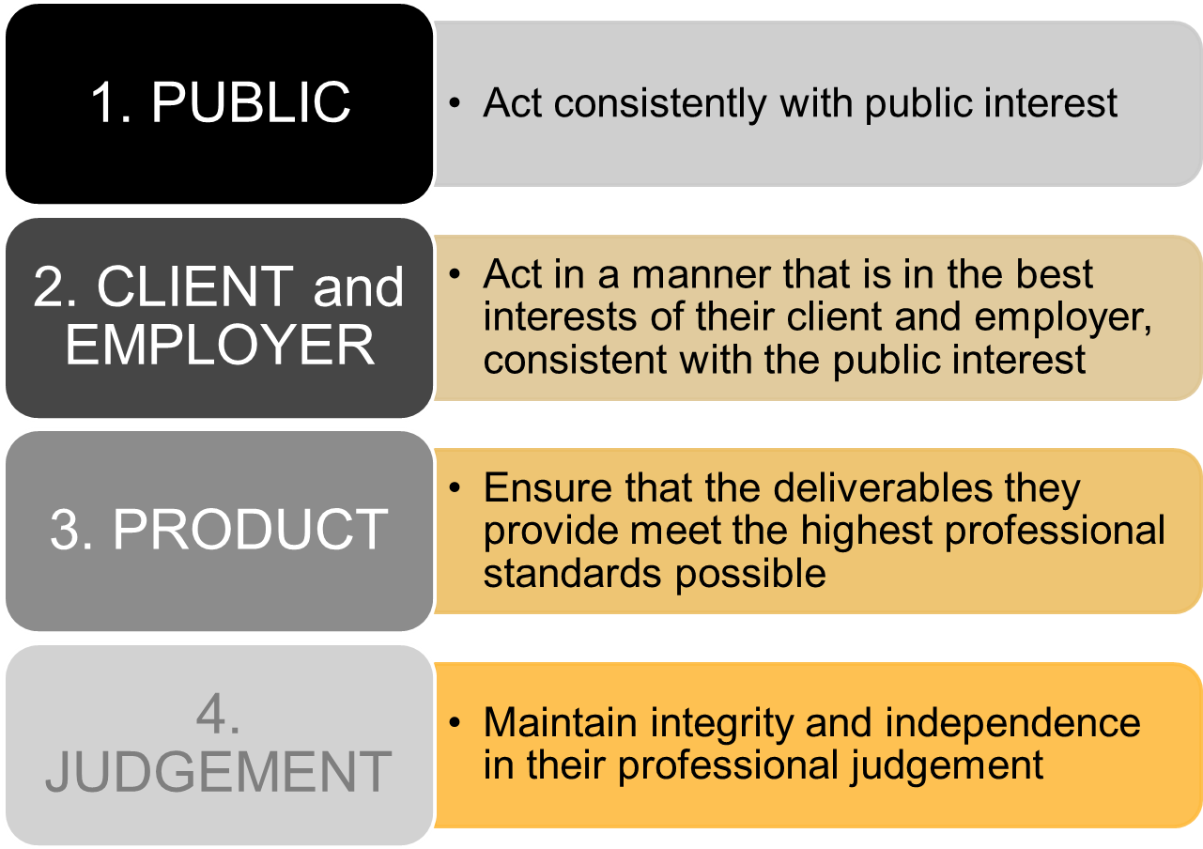
Code of Ethics(2/4) : ISTQB Code of Ethics

Slide 40
Code of Ethics(3/4) : ISTQB Code of Ethics
5. MANAGEMENT
Test managers and leaders shall subscribe to and promote an ethical approach
6. PROFESSION
Advance the integrity and reputation of the profession consistent with public interest
7. COLLEAGUES
Be fair to and supportive of their colleagues and promote co-operation with the public interest
8. SELF
Participate in lifelong learning regarding the practice of their profession and promote an ethical approach

Slide 41
End of Module 1
Questions?

Slide 42
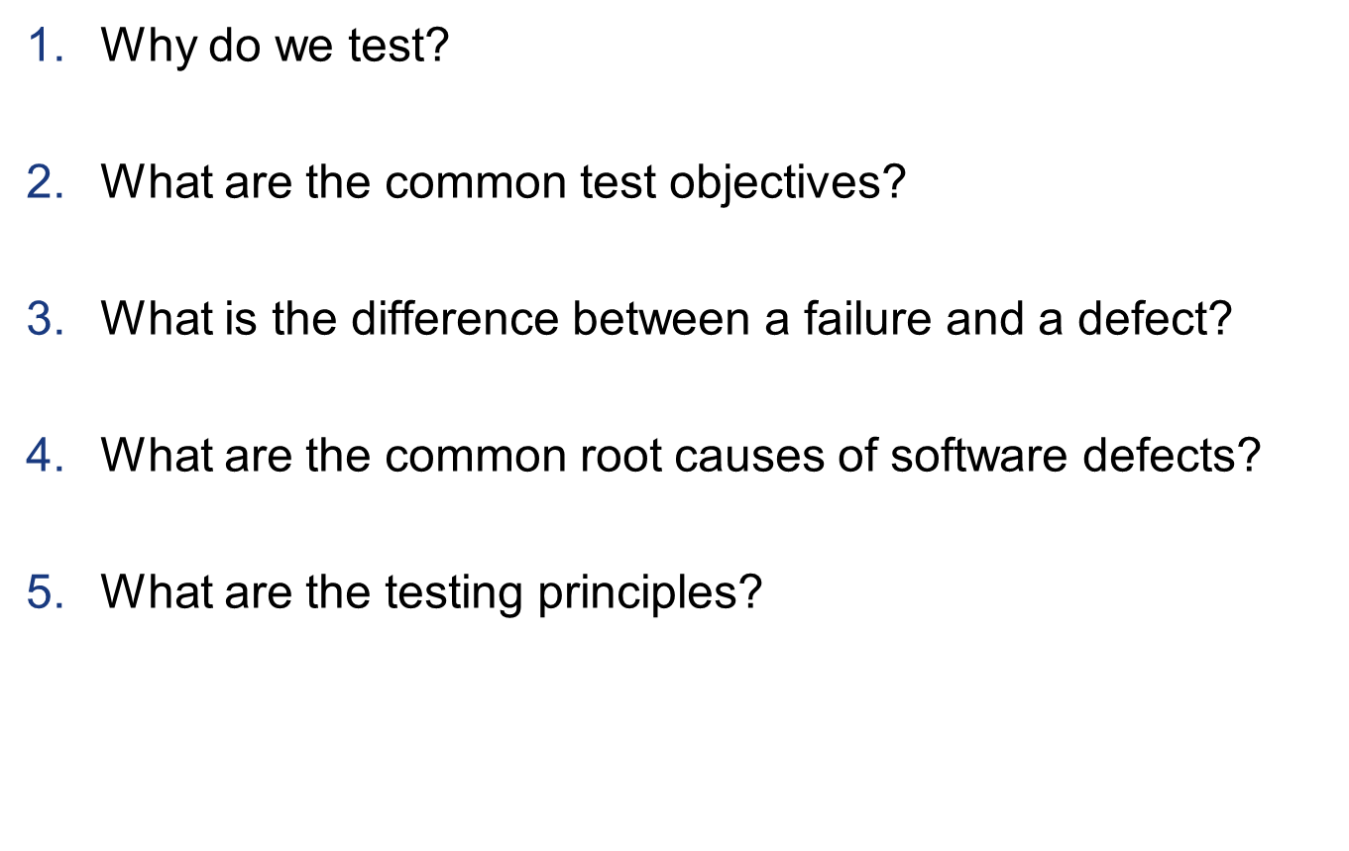
End of Module Learning Check - 1
To avoid or reduce risk of loss of money, time, reputation, injury or death
To find defects, gain confidence , to provide information
Failure is an anomaly, unexpected event. Defect is a fault in code or doc
Mistakes caused by time pressures, project constraints and complexity
Test early, Testing shows a presence of defects, Exhaustive testing is impossible, Defect cluster, Pesticide Paradox, Absence-of-errors fallacy, Testing is context dependent
Notes:
Answers:
1. To avoid or reduce risk of loss of money, time, reputation, injury or death
2. To find defects, gain confidence , to provide information
3. Failure is an anomaly, unexpected event. Defect is a fault in code or doc
4. Mistakes caused by time pressures, project constraints and complexity
5. Test early, Testing shows a presence of defects, Exhaustive testing is impossible, Defect cluster, Pesticide Paradox, Absence-of-errors fallacy, Testing is context dependent

Slide 43
End of Module Learning Check - 2
What is the fundamental test process?
What activities are in Test Closure?
Which step of the Fundamental Test Process does “identifying test data” fall in to?
9. What is the code of ethics for testers?
Planning and Control, Analysis and Design, Implementation and Execution, Evaluate Exit Criteria and Reporting
Test Closure
Check deliverables have been delivered, close incident reports, raise change requests, document acceptance, finalise and archive testware, hand over to maintenance, lessons learned, improve test maturity
Analysis and Design
Public, Client and Employer, Self, Product, Management, Profession
Colleagues, Judgement
Notes:
Answers:
6. Planning and Control, Analysis and Design, Implementation and Execution, Evaluate Exit Criteria and Reporting Test Closure
7. Check deliverables have been delivered, close incident reports, raise change requests, document acceptance, finalise and archive testware, hand over to maintenance, lessons learned, improve test maturity
8. Analysis and Design
9. Public, Client and Employer, Self, Product, Management, Profession Colleagues, Judgement

Slide 44
ISQTB Sample Exam Practice Question 1
Which one of the following describes best the difference between testing and debugging?
A. Testing shows failures that are caused by defects.
Debugging finds, analyzes, and removes the causes of failures in the software.
B. Testing pinpoints the defects. Debugging analyzes the faults and proposes preventing activities.
C. Testing removes faults. Debugging identifies the causes of failures.
D. Dynamic testing prevents causes of failures. Debugging removes the failures.
Notes:
Justification for Correct Answer
This is a true false question that requires a clear understanding of the different activities for getting rid of a wrong behavior of the application.
1. It starts with the observation that an observed behavior is wrong (=the failure), writing down the context where the failure can be
observed, 2. Pinpointing the failure, in order have as much information about the behavior by using different data, different options, testing variants of
the failed tests, and 3. The analyzing the code in order to find the wrong peace of software, and then remove it.
A good tester does pinpointing When a defect is reported from field use, developers may do then pinpointing.
Wrong is in B: Debugging is not proposing preventive actions.
Wrong is in C: Testing does not remove a fault
Wrong is in D: Tester prevents

Slide 45
ISQTB Sample Exam Practice Question 2
Below you find a list of descriptions of problems that can be observed during testing or operation. Which is most likely a failure?
The product crashed when the user selected an option in a dialog box.
One source code file included in the build was the wrong version
The computation algorithm used the wrong input variables.
The developer misinterpreted the computational requirement for that algorithm.
Notes:
Justification for Correct Answer
A is clearly a failure that can be observed during testing.
B From the perspective of the configuration adding a wrong version is a
fault, most probably based on a mistake by the developer / CM manager
C Fault
D Mistake

Slide 46
Reference
ISTQB Certified Tester Foundation Level Syllabus, Version 2010, pp10-19
http://gizmodo.com/5467388/software-bug-causes-toyota-recall-of-almost-half-a-million-new-hybrid-cars
www.istqb.org
http://www.istqb.org/display/ISTQB/Downloads?atl_token=9voKHV6hij
www.anztb.org
All images without reference are provided by Microsoft
ISTQB Practice exam questions
-LO-1.1.5-Q1-K2
-LO-1.2.3_Q1_K2

Slide 47
Software Systems(1/4)
Software is an integral part of life
Business applications (eg. banking, factory machines)
Consumer products (eg. cars, washing machines)
Software is everywhere!
Example where software didn’t work correctly…
In 2010 the Toyota Prius was dogged by software bugs that caused uneven braking in the car’s antilock brake system (ABS). Toyota had to recall nearly half a million of these hybrid cars.
What bugs have you found?
Notes:
LO-1.1.1 Describe, with examples, the way in which a defect in software can cause harm to a
person, to the environment or to a company (K2)

Slide 48
Software Systems(2/4)
What are some of the consequences of faulty software?
Loss of Money
Loss of Time
Loss of Reputation
Injury or Loss of Life
Example :
A company gets sued because an advertised business listing didn’t display correctly
Example :
A defect caused a delay in a call center, so that not as many calls could be answered
Example :
Brand was damaged by ongoing performance issues of a major airline, so customers went elsewhere
Example:
Malfunction of switching in a railway line caused trains to collide

